Slide 1
AZ-100.1 Module 04: Log Analytics

Slide 2
Lesson 01: Introduction to Log Analytics

Slide 3
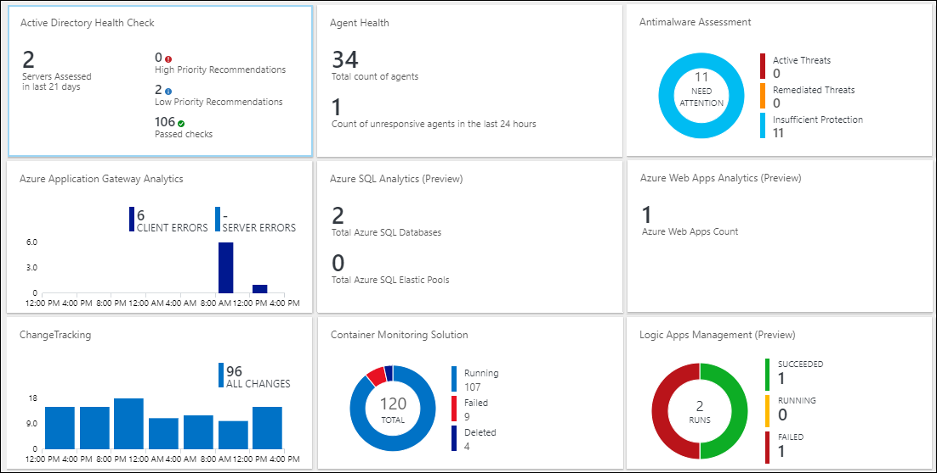
Video: Log Analytics
Notes:
✔ Log Analytics helps you collect, correlate, search, and act on log and performance data generated by operating systems and applications. It gives you real-time operational insights using integrated search and custom dashboards to readily analyze millions of records across all your workloads and servers regardless of their physical location. Log Analytics gives you a single interface for consuming and correlating the data, covering both Linux and Windows Server.

Slide 4
Log Analytics Scenarios
Example 1 - Assessing updates
IT Administrators assess systems update requirements
Must be able to accurately schedule updates
OMS/Log Analytics collects data from all customers performing updates
Uses "Crowd-sourced" data to provide an average time to help meet strict SLAs
Example 2 - Change tracking
Troubleshooting operational incidents is a complex process
OMS/Log Analytics let you perform analysis from multiple angles, using a variety of sources
Everything correlated through a single interface
Track issues such as unexpected system reboots or shutdowns
Notes:
For more information, you can see:
‎What is Log Analytics? https://docs.microsoft.com/en-us/azure/log-analytics/log-analytics-overview
What’s new in Microsoft Operations Management Suite: Log Analytics - https://blog.tyang.org/wp-content/uploads/2016/04/Whats-New-in-OMS.pdf
Log Analytics FAQ - https://azure.microsoft.com/en-us/services/log-analytics/faq/
Unified Alerts in Log Analytics - https://docs.microsoft.com/en-us/azure/log-analytics/log-analytics-alerts

Slide 5
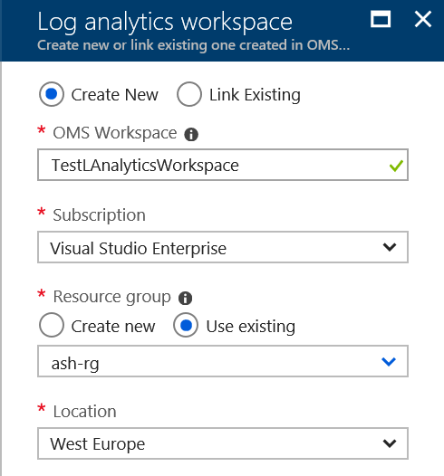
Create a Workspace
A workspace is an Azure resource and is a container where data is collected, aggregated, analyzed, and presented
You can have multiple workspaces per Azure subscription and you can have access to more than one workspace
A workspace provides a geographic location, data isolation, and scope
Notes:
For more information, see:
Create a Workspace – https://docs.microsoft.com/en-us/azure/log-analytics/log-analytics-quick-collect-azurevm#create-a-workspace

Slide 6
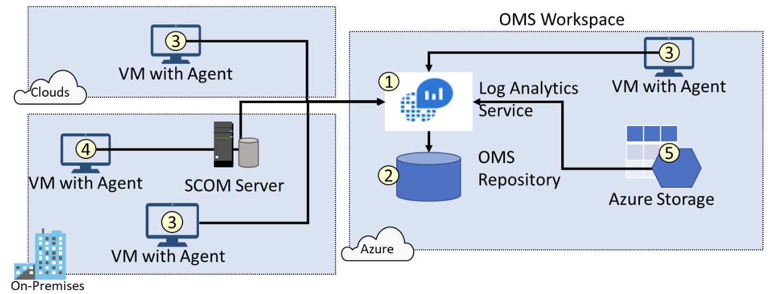
Connected Sources
Connected sources generate data
Data can be collected from Windows, Linux, SCOM and Azure Storage
Notes:
For more information, you can see:
Connecting Computers to the Log Analytics Service - https://docs.microsoft.com/en-us/azure/log-analytics/log-analytics-windows-agents#system-requirements-and-required-configuration

Slide 7
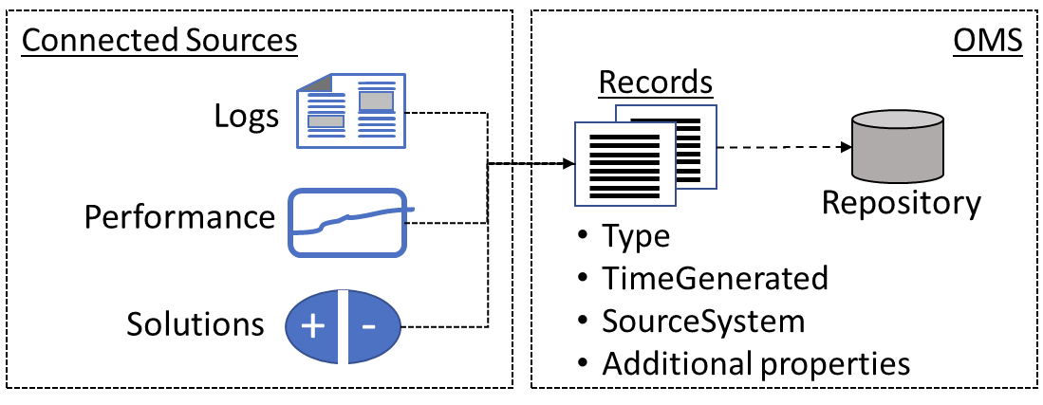
Data Sources
Data sources include: Windows Event Logs, Windows Performance Counters, Linux Performance Counters, IIS Logs, Custom Fields, Custom Logs, and Syslog.
Each data source has additional configuration options.
Notes:
For more information, you can see:
Data Sources in Log Analytics - https://docs.microsoft.com/en-us/azure/log-analytics/log-analytics-data-sources

Slide 8
Demonstration: Log Analytics

Slide 9
Additional Practice: Visualize Data
Create a Log Analytics dashboard and add log search
Create a shared dashboard in the Azure portal
Visualize a performance log search
Add a log search to a shared dashboard
Customize the dashboard
Notes:
✔️ In this tutorial, you learned how to create a dashboard in the Azure portal and add a log search to it. In the next tutorial you will learn the different responses you can implement based on log search results.

Slide 10
Additional Practice: Alert on Data
Respond to events with Azure Monitor alerts
Create an alert based on a Log Analytics workspace
Configure an Action Group to send an email notification
Notes:
✔️ In this tutorial, you learned to create an alert based on your Log Analytics workspace and then defined a custom log search. You then activated your alert and created an Action Group to send an email notification each time the alert is triggered.

Slide 11
Lesson 02: Querying and Analyzing Log Analytics Data

Slide 12
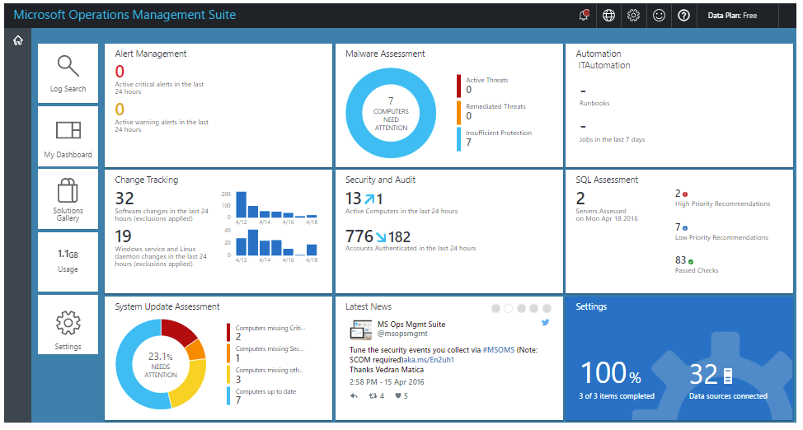
Analyzing Log Analytics Data
Leverage log searches, construct queries, customize views
OMS portal capabilities are moving to the Azure portal
Notes:
✔ In response to customer feedback to consolidate monitoring and management of both on premises and Azure workloads into a single user experience, OMS portal capabilities have been added into the Azure portal.
For more information, you can see:
OMS portal moving to Azure – https://docs.microsoft.com/en-us/azure/log-analytics/log-analytics-oms-portal-transition

Slide 13
Additional Practice: Collect and Analyze Data
Part 1
Collect data about virtual machines
Create a workspace
Enable Log Analytics on virtual machines
Collect event and performance data
View the data collected
Part 2
View or analyze data collected with Log Analytics search
Search, modify, and filter event data
Work with performance data
Notes:
✔️ In the next tutorial you will learn how to visualize the data by creating a dashboard.
For more information, you can see:
Writing a query - https://docs.microsoft.com/en-us/azure/log-analytics/log-analytics-log-search#writing-a-query

Slide 14
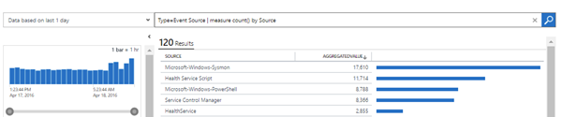
Log Analytics Querying
Log Analytics provides a query syntax
Quickly retrieve and consolidate data in the repository
Save or have log searches run automatically to create an alert
Export the data to Power BI or Excel
Notes:
For more information, you can see:
Azure Log Analytics – meet our new query language - https://azure.microsoft.com/en-us/blog/azure-log-analytics-meet-our-new-query-language-2/

Slide 15
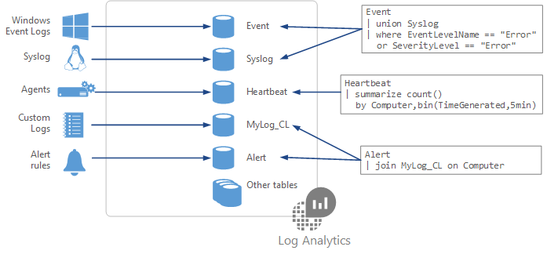
Query Language Syntax
Event
| where (EventLevelName == "Error")
| where (TimeGenerated > ago(1days))
| summarize ErrorCount = count() by Computer
| top 10 by ErrorCount desc
Notes:
✔ You can try this query and many others during the Additional Practice: Log Analytics Queries.
For more information, you can see:
Understanding log searches in Log Analytics - https://docs.microsoft.com/en-us/azure/log-analytics/log-analytics-log-search

Slide 16
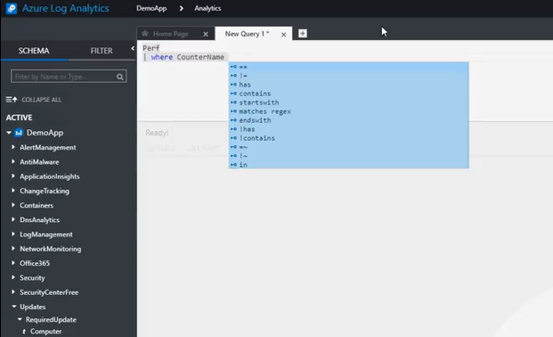
Demonstration: Log Analytics Querying
Intellisense for query completion

Slide 17
Practice: Log Analytics Query
Access the live Log Analytics Querying Demonstration workspace where you can run and test queries
Some of the testing queries are
See the volume of data collected in the last 24 hours in intervals of 30 minutes
Chart the distribution of billable data by type, over the last 24 hours
Find out which computers were alive in the past 2 days but haven't sent any data in the last 6 hours
Notes:
✔ The reference link has additional queries you can try. Is there a specific query that will help with your day to day tasks?
For more information, you can see:
Getting Started with the Analytics Portal - https://portal.loganalytics.io/demo#/discover/home

Slide 18
Module 4: Review Questions
You work for a cloud solution provider as a technical pre-sales consultant. A customer is inquiring about Log Analytics. You need to help the customer understand why they should invest in the tool and what the benefits are. Can you give some specific examples of how to use Log Analytics?
An organization has a hybrid Azure infrastructure and has business-critical resources in Azure as well as the on-premises environment. You need to monitor resource usage. Describe how Connected Sources flow data to the Log Analytics service. Can you draw a diagram?
You implement Log Analytics for an organization. You collect substantial amounts of data. You need to visualize the data. What tools can you use?
Notes:
Q1 Answer:
Example 1 - Assessing updates. An important part of the daily routine for any IT administrator is assessing systems update requirements and planning patches. Accurate scheduling is critical, as it relates to SLAs to the business and can seriously affect business functions. In the past, you had to schedule an update with only limited knowledge of how long the patching would take. Operations Management Suite collects data from all customers performing patches and uses that data to give an average patching time for specific missing updates. This use of “crowd-sourced” data is unique to cloud systems and is a great example of how Log Analytics can help meet strict SLAs.
Example 2 - Change tracking. Troubleshooting an operational incident is a complex process. You often need access to multiple data streams. With Operations Management Suite, you can easily perform analysis from multiple angles, using data from a wide variety of sources through a single interface for correlation of information. By tracking changes throughout the environment, Log Analytics helps to easily identify things like abnormal behavior from a specific account, users installing unapproved software, unexpected system reboots or shutdowns, evidence of security breaches, or specific problems in loosely coupled applications.
Q2 Answer:
The Log Analytics service collects data and stores it in the OMS repository. The OMS Repository is hosted in Azure. Connected Sources provide information to the Log Analytics service.
Computer agents generate data to the Log Analytics service. These agents can run on Windows or Linux computers, virtual or physical computers, on-premises or cloud computers, and Azure or other cloud providers.
You can connect a System Center Operations Manager (SCOM) management group to Log Analytics. SCOM agents communicate with management servers which forward events and performance data to Log Analytics.
An Azure storage account can also collect Azure Diagnostics data from a worker role, web role, or virtual machine in Azure. This information can be sent to the Log Analytics service.
Q3 Answer:
To give a quick graphical view of the health of your overall environment, you can add visualizations for saved log searches to your dashboard. To analyze data outside of Log Analytics, you can export the data from the repository into tools such as Power BI or Excel. You can also use the Log Search API to build custom solutions that leverage Log Analytics data or to integrate with other systems.

